Slide 1

Convolution Neural Networks
with
Daniel L. Silver, Ph.D.
Andy McIntyre, Ph.D.
October 22, 2020
[Slides based on originals by Yann LeCun]

Slide 2
Convolution Neural Networks
Fundamental CNNs take advantage of knowledge that the architect has about the problem’s input space
We know that pixels in an image that are adjacent to each other are related – similar color and brightness
We can use this background knowledge as a source of inductive bias to help develop better NN models

Slide 3
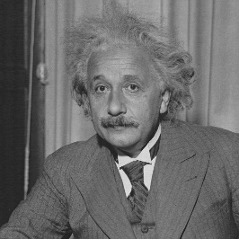
Receptive Fields
The receptive field of an individual sensory neuron is the particular region of the sensory space (e.g. the retina) in which a stimulus will trigger the firing of that neuron.
It is a feature detector (image line orientation, sound frequency)
How do we design “proper” receptive fields for the input neurons?
Consider a task with image inputs
Receptive fields should provide expressive features from the raw input
How would you design the receptive fields for this problem?

Slide 4
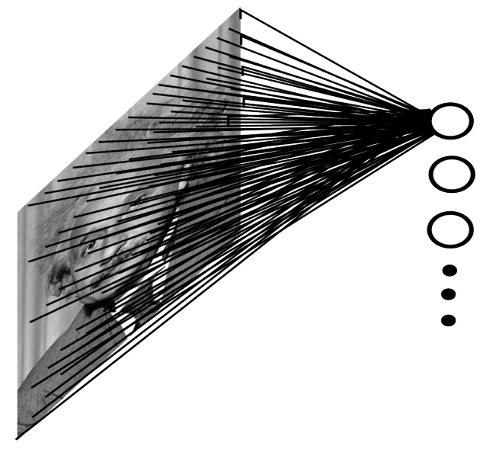
Solution 1
A fully connected layer and network:
Example:
100x100 images
1000 units in 1st hidden layer
Problems:
10^7 edges!
Local spatial correlations lost!
Variable sized inputs.
Slide Credit: Marc'Aurelio Ranzato

Slide 5
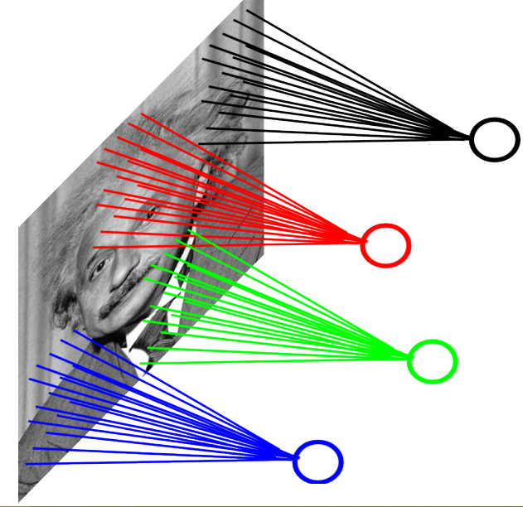
Solution 2
A locally connected layer:
Example:
100x100 images
1000 units in the input
Filter size: 10x10
Local correlations preserved!
Problems:
10^5 edges
This parameterization is good
when input image is
registered (e.g., face recognition).
Variable sized inputs, again.
Slide Credit: Marc'Aurelio Ranzato

Slide 6

Variation of Objects In Images
Fixed objects can vary in terms of:
Translation (location)
Rotation
Scale
Handwritten digits can vary due to nuances of pen stroke

Slide 7
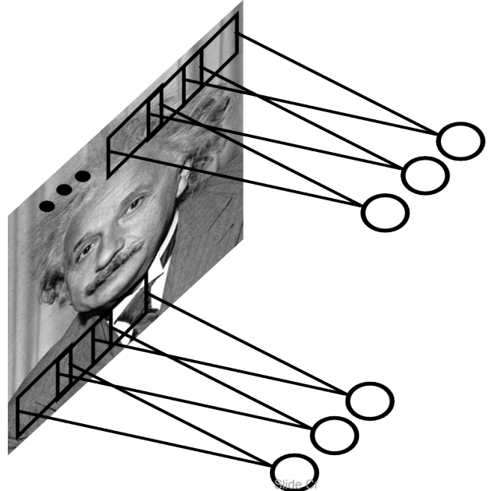
Better Solution - Convolution
A solution:
Filters to capture different patterns in the input space.
Share parameters across different locations or rotations
Convolutions with learned filters
Filters will be learned during training.
The issue of variable-sized inputs will be
resolved with a pooling layer.
So what is a convolution?
Slide Credit: Marc'Aurelio Ranzato

Slide 8
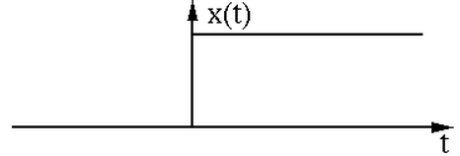
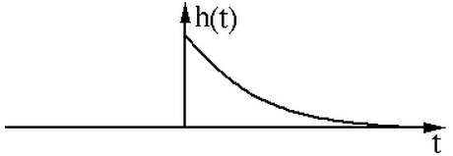
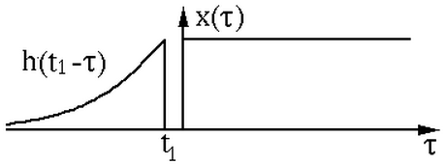
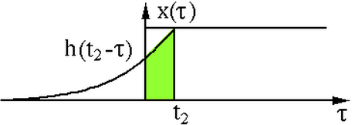
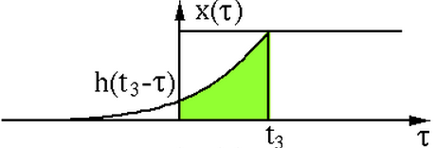
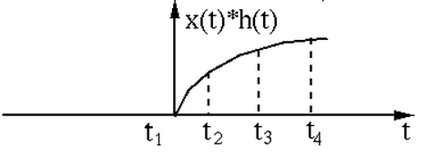
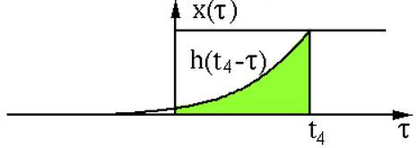
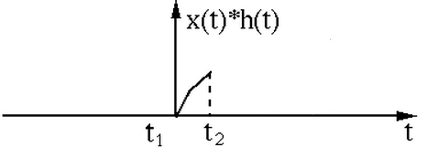
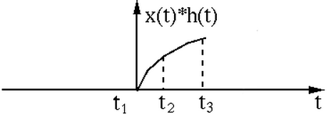
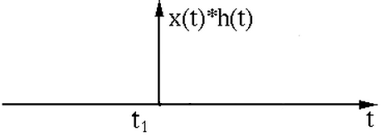

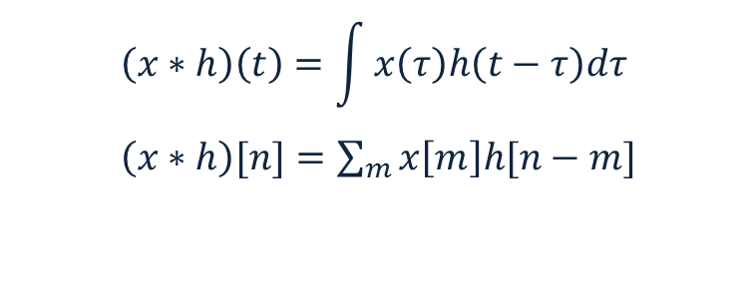
Convolution Operator
“Convolution” is very similar to “cross-correlation”, except that in convolution one of the functions is flipped.
Convolution operator: $∗$
takes two functions and gives another function
One dimension:
$$\left(x∗h\right)\left(t\right)=\int{x\left(τ\right)h\left(t−τ\right)dτ}$$
$\left(x∗h\right)[n]=\sum_{m}{x\left[m\right]h[n−m]}$
Example convolution:

Slide 9
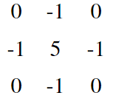
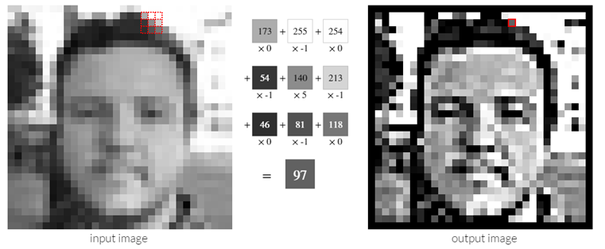
Convolution Operator
Convolution in two dimension:
Takes two functions and produces another function
2D: Take one matrix and slide it over the other matrix
Example: Sharpen kernel:
Try other kernels: http://setosa.io/ev/image-kernels/

Slide 10
Convolution Operator

Slide 11
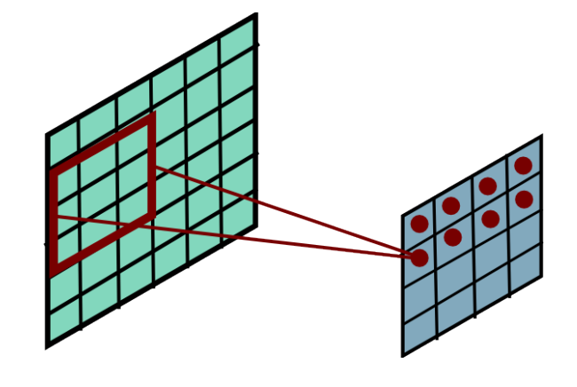
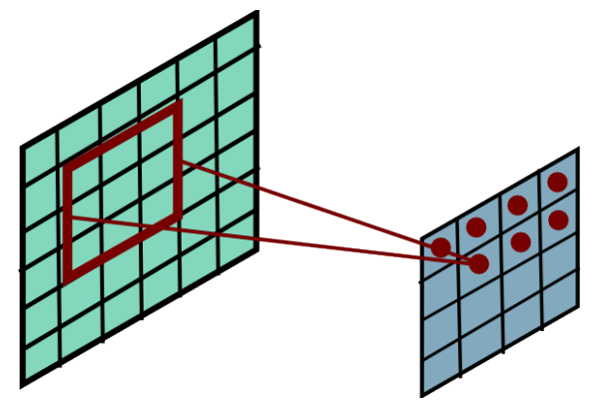
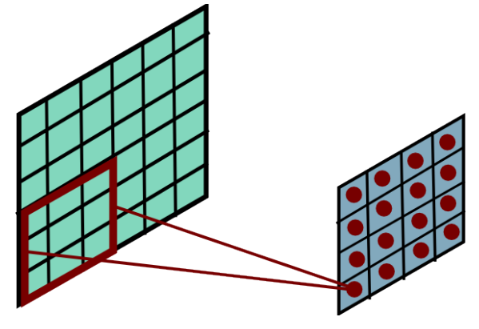
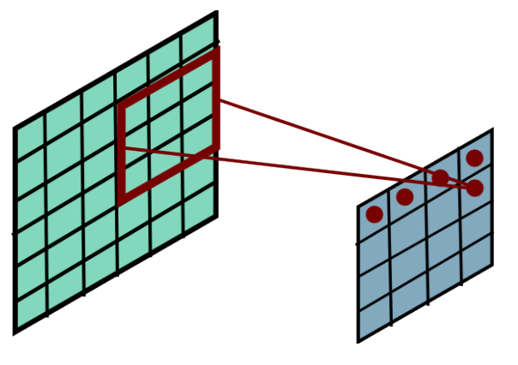
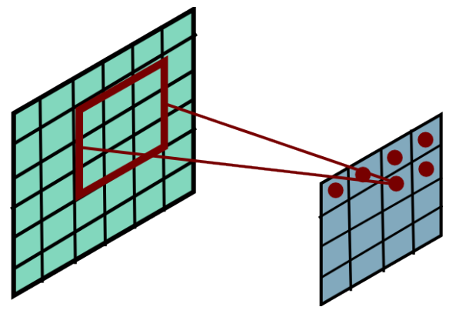
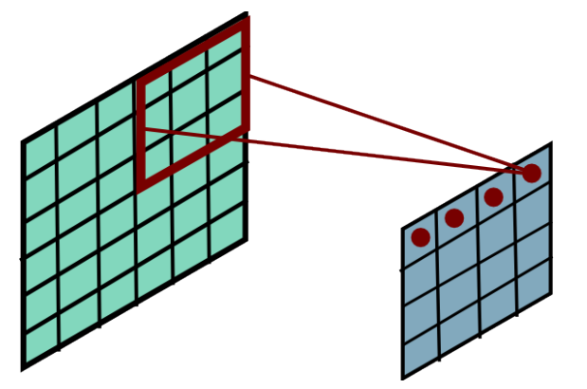
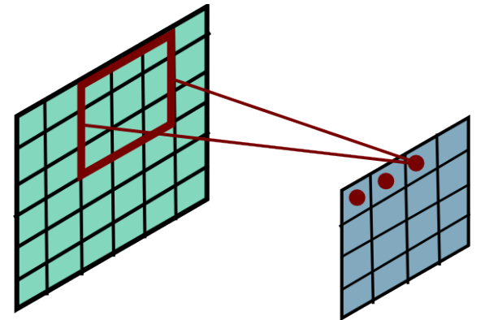
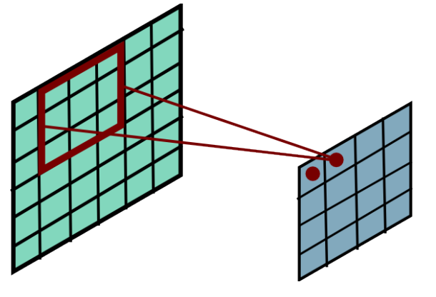
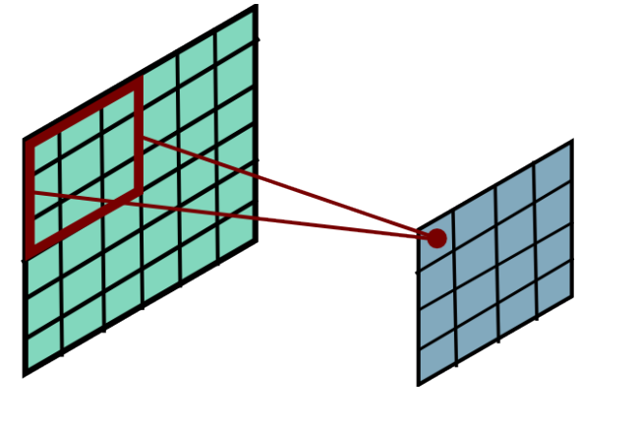
Convolution Operator
Convolution in two dimension:
The same idea: flip one matrix and slide it on the other matrix
Slide Credit: Marc'Aurelio Ranzato

Slide 12

Complexity of Convolution
Complexity of convolution operator is $nlog\left(n\right)$, for $n$ inputs.
Uses Fast-Fourier-Transform (FFT)
For two-dimension, each convolution takes $MNlog\left(MN\right)$ time, where the size of input is $MN$.
Slide Credit: Marc'Aurelio Ranzato

Slide 13
Convolutional Layer
The convolution of the input (vector/matrix) with weights (vector/matrix) results in a response vector/matrix.
We can have multiple filters in each convolutional layer, each producing an output.
If it is an intermediate layer, it can have multiple inputs!
Convolutional Layer
Filter
Filter
Filter
One can add nonlinearity at the output of convolutional layer
Filter

Slide 14
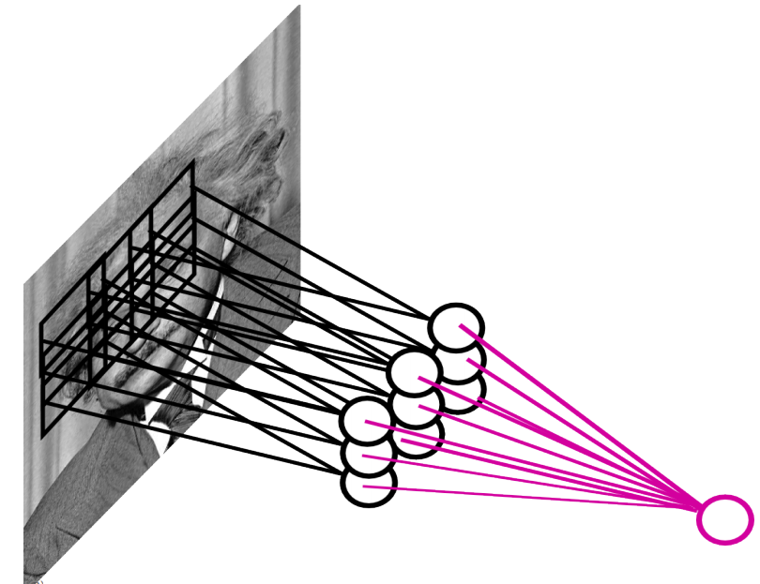
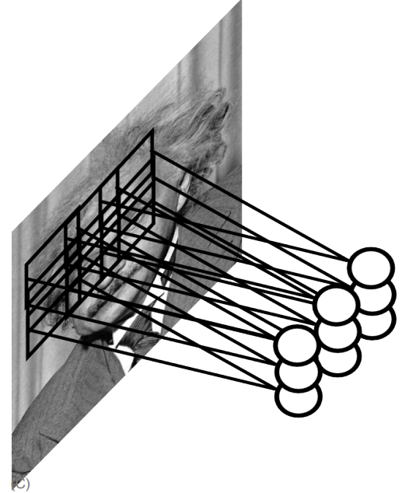
Pooling Layer
How to handle variable sized inputs?
A layer which reduces inputs of different size, to a fixed size.
Pooling
Slide Credit: Marc'Aurelio Ranzato

Slide 15
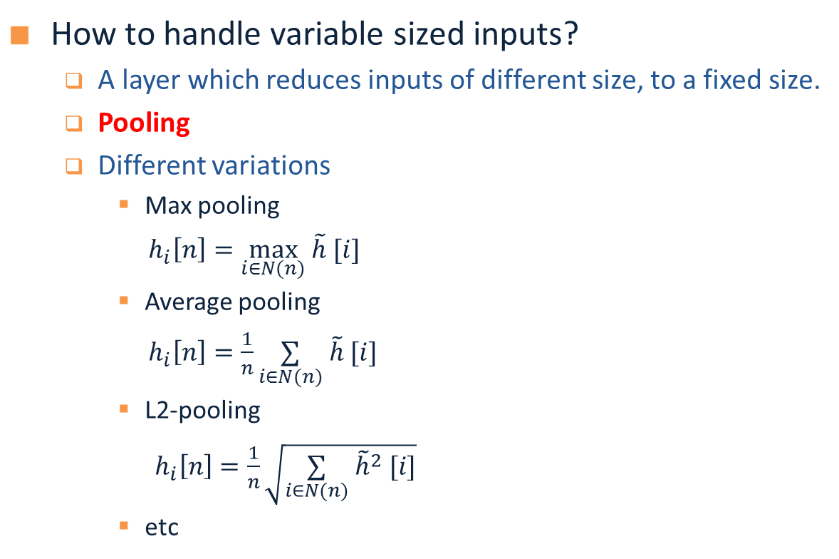
Pooling Layer
How to handle variable sized inputs?
A layer which reduces inputs of different size, to a fixed size.
Pooling
Different variations
Max pooling
$h_{i}\left[n\right]=\max_{i∈N(n)} \tilde{h} [i]$
Average pooling
$h_{i}\left[n\right]=\frac{1}{n}\underset{i∈N(n)}{∑} \tilde{h} [i]$
L2-pooling
$h_{i}\left[n\right]=\frac{1}{n}\sqrt{\underset{i∈N(n)}{∑} {\tilde{h}}^{2} [i]}$
etc
45
15
34
23
45

Slide 16
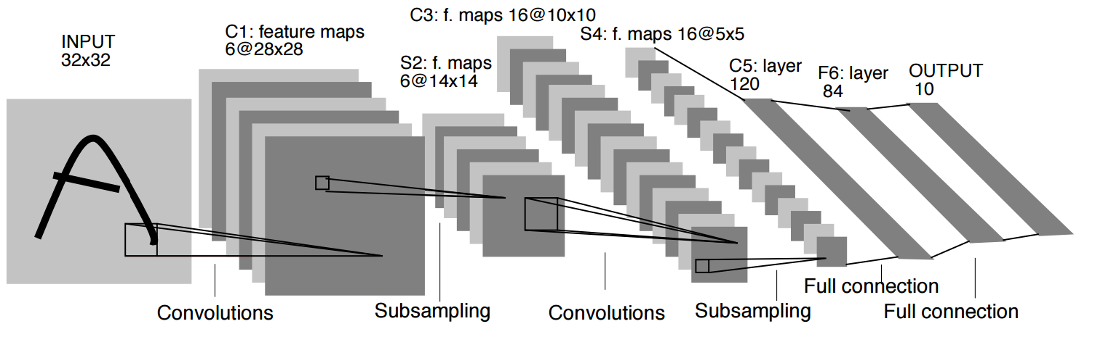
Convolutional Nets
One stage structure:
Whole system:
Convol.
Pooling
Stage 1
Stage 2
Stage 3
Fully Connected Layer
Input Image
Class Label
An example system (LeNet):
Slide Credit: Druv Bhatra

Slide 17


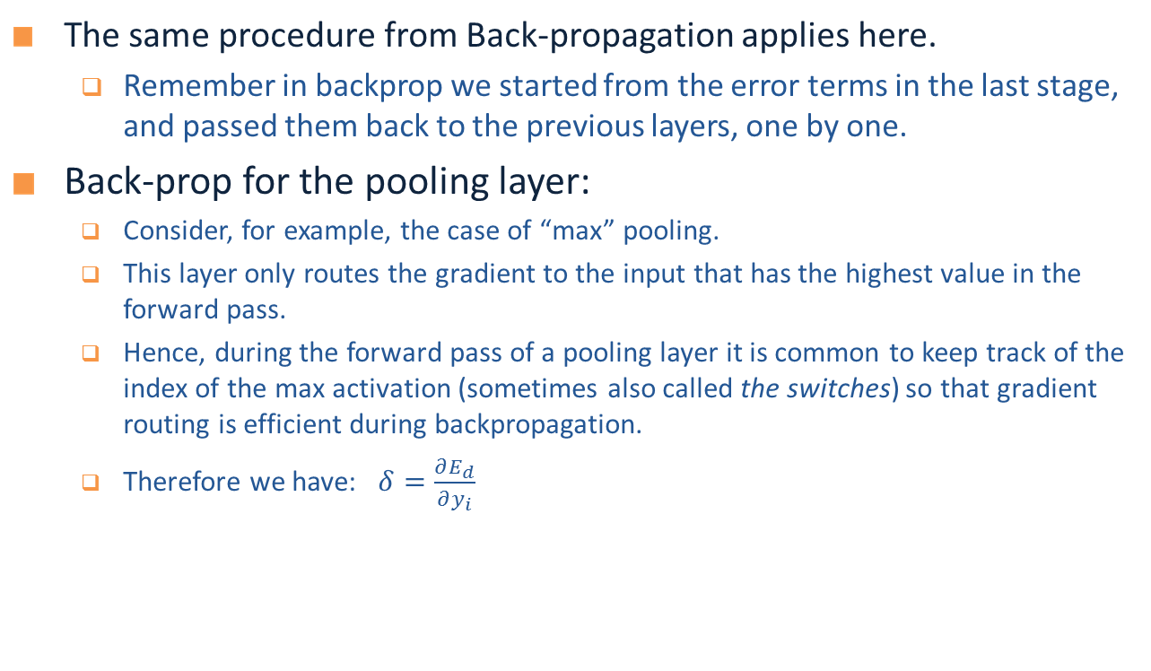



Training a ConvNet
The same procedure from Back-propagation applies here.
Remember in backprop we started from the error terms in the last stage, and passed them back to the previous layers, one by one.
Back-prop for the pooling layer:
Consider, for example, the case of “max” pooling.
This layer only routes the gradient to the input that has the highest value in the forward pass.
Hence, during the forward pass of a pooling layer it is common to keep track of the index of the max activation (sometimes also called the switches) so that gradient routing is efficient during backpropagation.
Therefore we have: $δ=\frac{∂E_{d}}{∂y_{i}}$
$$x_{i}$$
$$y_{i}$$
$$δ_{last−layer}=\frac{∂E_{d}}{∂y_{last−layer}}$$
Convol.
Pooling
$$δ_{first−layer}=\frac{∂E_{d}}{∂y_{first−layer}}$$
$$E_{d}$$
Input Image
Stage 1
Stage 2
Stage 3
Fully Connected Layer
Class Label

Slide 18


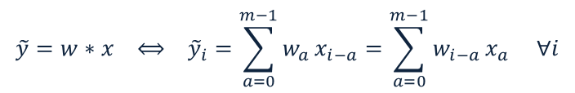








Training a ConvNet
Back-prop for the convolutional layer:
We derive the update rules for a 1D convolution, but the idea is the same for bigger dimensions.
$$\tilde{y}=w∗x ⟺ {\tilde{y}}_{i}=\sum_{a=0}^{m−1}{w_{a}}x_{i−a}=\sum_{a=0}^{m−1}{w_{i−a}}x_{a} ∀i$$
The convolution
$$y=f\left(\tilde{y}\right) ⟺ {y_{i}=f(\tilde{y}}_{i}) ∀i$$
A differentiable nonlinearity
$$\frac{∂E_{d}}{∂w_{a}}=$$
$$\sum_{i=0}^{m−1}{\frac{∂E_{d}}{∂{\tilde{y}}_{i}}\frac{∂{\tilde{y}}_{i}}{∂w_{a}}}$$
$$=\sum_{i=0}^{m−1}{\frac{∂E_{d}}{∂{\tilde{y}}_{i}}x_{i−a}}$$
$$\frac{∂E_{d}}{∂{\tilde{y}}_{i}}=$$
$$\frac{∂E_{d}}{∂y_{i}}\frac{∂y_{i}}{∂{\tilde{y}}_{i}}$$
$$=\frac{∂E_{d}}{∂y_{i}}f′(\tilde{y})$$
Now we have everything in this layer to update the filter
Now we can repeat this for each stage of ConvNet.
$$δ= \frac{∂E_{d}}{∂x_{a}}=$$
$$\sum_{i=0}^{m−1}{\frac{∂E_{d}}{∂{\tilde{y}}_{i}}\frac{∂{\tilde{y}}_{i}}{∂x_{a}}}$$
$$=\sum_{i=0}^{m−1}{\frac{∂E_{d}}{∂{\tilde{y}}_{i}}w_{i−a}}$$
We need to pass the gradient to the previous layer
$$x_{i}$$
$$y_{i}$$
$$δ_{last−layer}=\frac{∂E_{d}}{∂y_{last−layer}}$$
Convol.
Pooling
$$δ_{first−layer}=\frac{∂E_{d}}{∂y_{first−layer}}$$
$$E_{d}$$
Input Image
Stage 1
Stage 2
Stage 3
Fully Connected Layer
Class Label

Slide 19
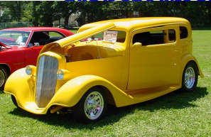
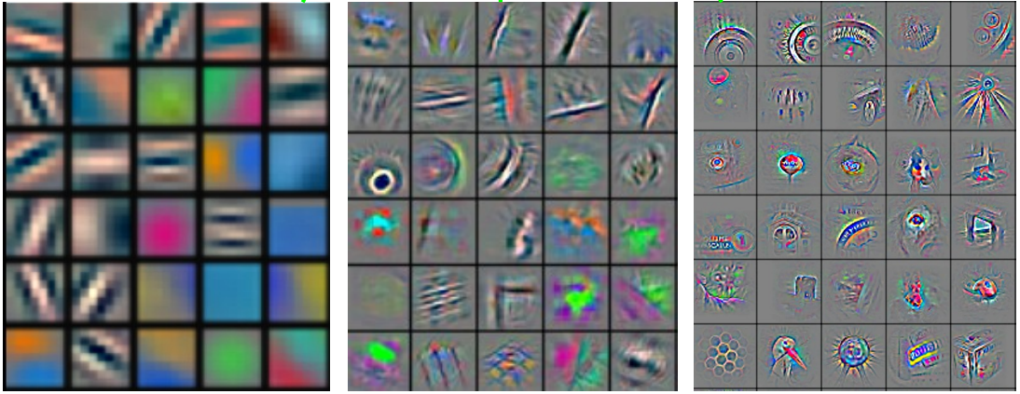
Convolutional Nets
Stage 1
Stage 2
Stage 3
Fully Connected Layer
Input Image
Class Label
An example system :
Feature visualization of convolutional net trained on ImageNet from [Zeiler & Fergus 2013]

Slide 20
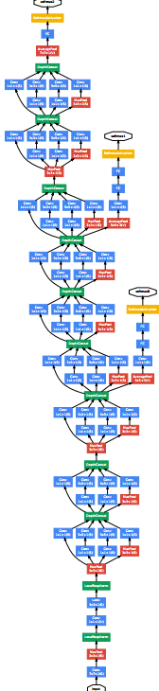
ConvNet roots
Fukushima, 1980s designed network with same basic structure but did not train by backpropagation.
The first successful applications of Convolutional Networks by Yann LeCun in 1990's (LeNet)
Was used to read zip codes, digits, etc.
Many variants nowadays, but the core idea is the same
Example: a system developed in Google (GoogLeNet)
Compute different filters
Compose one big vector from all of them
Layer this iteratively
Demo!
See more: http://arxiv.org/pdf/1409.4842v1.pdf

Slide 21
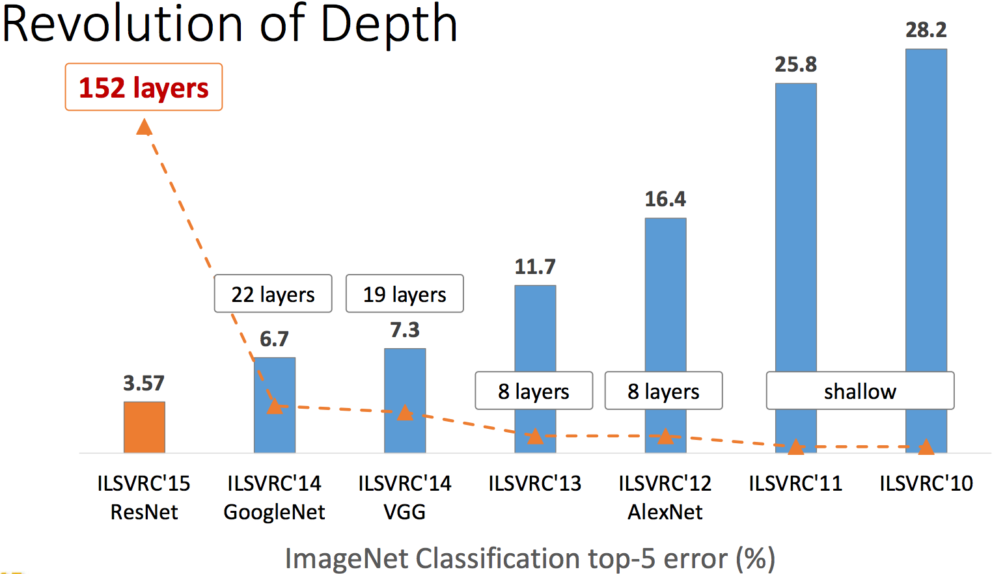
Depth matters
Slide from [Kaiming He 2015]

Slide 22
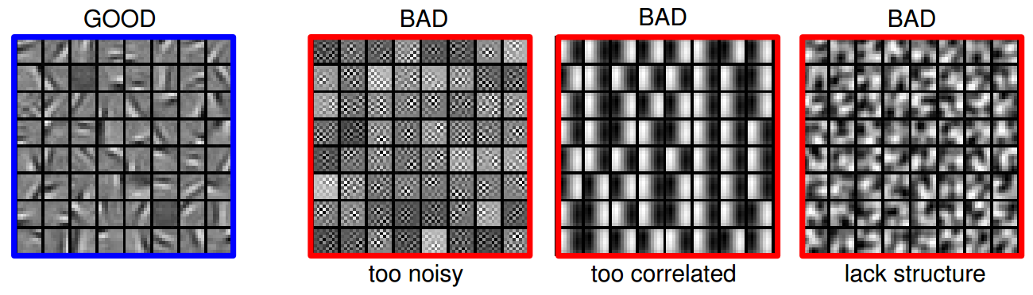
Practical Tips
Before large scale experiments, test on a small subset of the data and check the error should go to zero.
Overfitting on small training
Visualize features (feature maps need to be uncorrelated) and have high variance
Bad training: many hidden units ignore the input and/or exhibit strong correlations.
Figure Credit: Marc'Aurelio Ranzato

Slide 23
Debugging
Training diverges:
Learning rate may be too large → decrease learning rate
BackProp is buggy → numerical gradient checking
Loss is minimized but accuracy is low
Check loss function: Is it appropriate for the task you want to solve? Does it have degenerate solutions?
NN is underperforming / under-fitting
Compute number of parameters → if too small, make network larger
NN is too slow
Compute number of parameters → Use distributed framework, use GPU, make network smaller
Many of these points apply to many machine learning models, no just neural networks.

Slide 24
TUTORIAL 4
Develop and train a CNN network using Keras and Tensorflow (keras_mnist_cnn_val.ipynb)
Notes:
Rbm.py

Slide 25
References
Demo: http://scs.ryerson.ca/~aharley/vis/conv/
Further Reading:
https://ujjwalkarn.me/2016/08/11/intuitive-explanation-convnets/
https://adeshpande3.github.io/A-Beginner's-Guide-To-Understanding-Convolutional-Neural-Networks-Part-2/

